Slide 1
Summer 2017 Internship Experience
Presented by:
Drew Hamroff, Distribution Intern
August 4th , 2017

Slide 2





Presentation Overview
About Me
Scotts Run Station
Lessons Learned
Questions

Slide 3
About Me

Slide 4
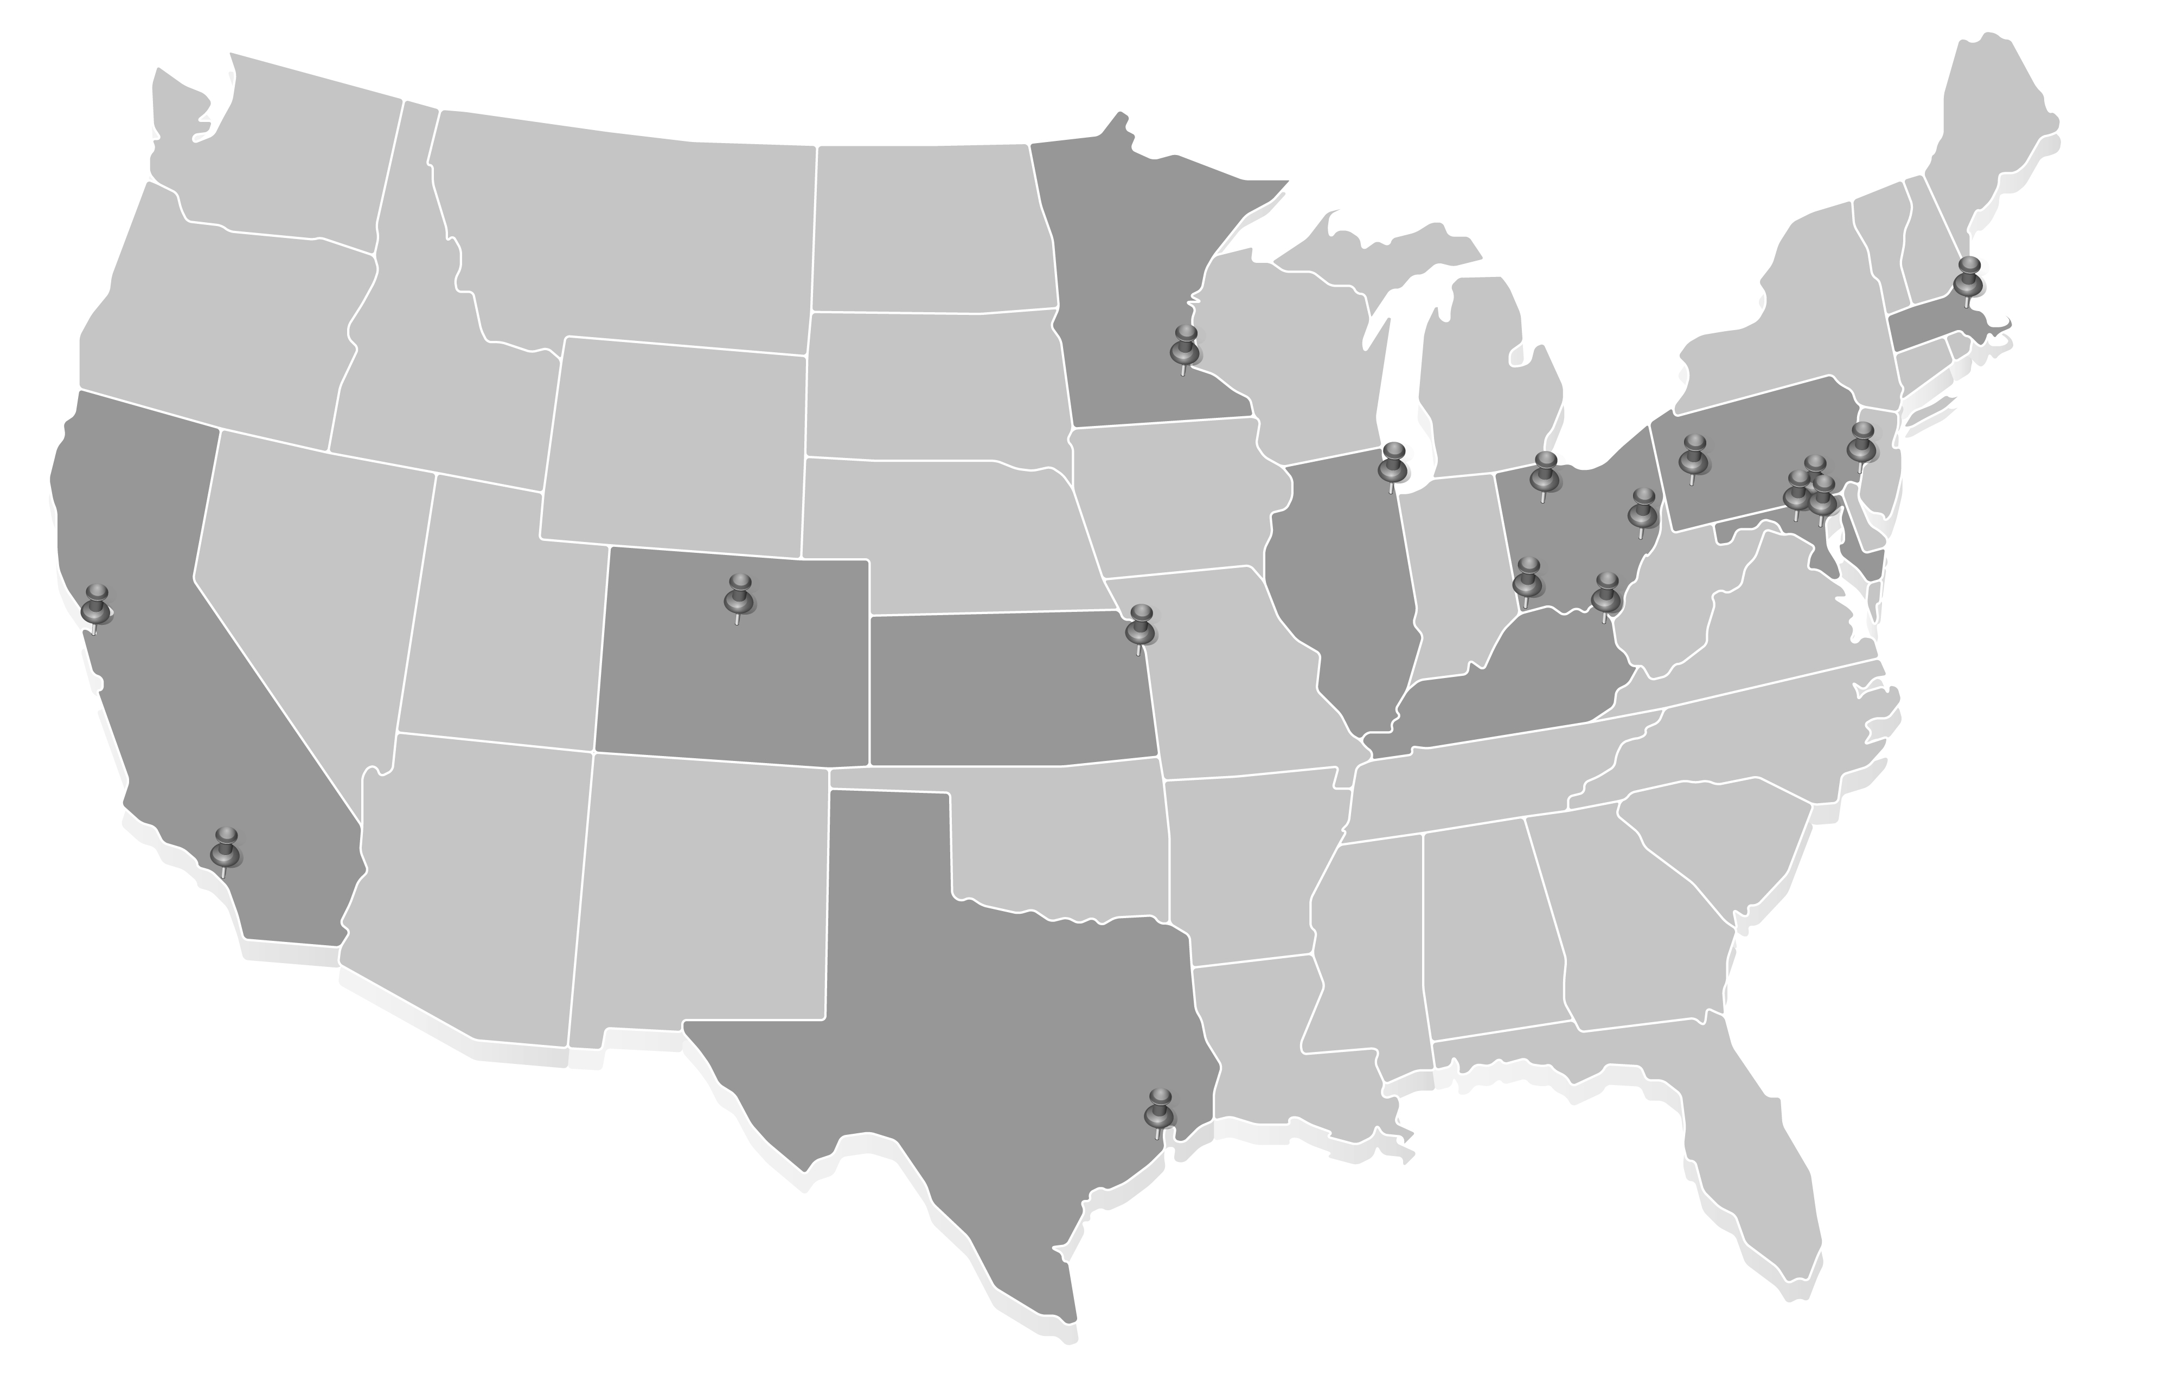

About Me
Drew Hamroff
Rising Junior
Mechanical Engineering @ the University of Maryland
Long Island, New York
Distribution Intern – Glenn Burnie Office

Slide 5
About Me
Drew Hamroff
Rising Junior
Mechanical Engineering @ the University of Maryland
Long Island, New York
Distribution Intern – Glenn Burnie Office

Slide 6
About Me
Drew Hamroff
Rising Junior
Mechanical Engineering @ the University of Maryland
Long Island, New York
Distribution Intern – Glenn Burnie Office

Slide 7
About Me
Drew Hamroff
Rising Junior
Mechanical Engineering @ the University of Maryland
Long Island, New York
Distribution Intern – Glenn Burnie Office

Slide 8
Scotts Run Station

Slide 9
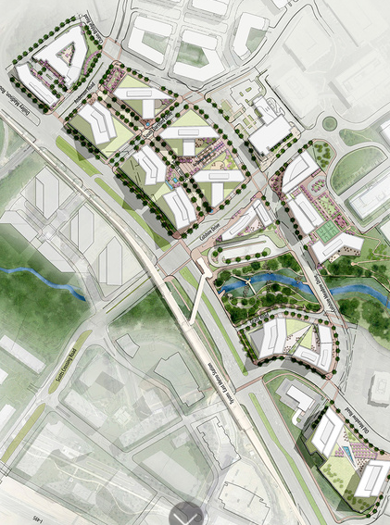
Scotts Run Station
Developer project in Tysons Corner, Virginia by SmithGroup JJR
17 new buildings (Residential, Office, Retail)
“Transform this part of the suburban edge city into a true urban center”

Slide 10
Scotts Run Station
Developer project in Tysons Corner, Virginia by SmithGroup JJR
17 new buildings (Residential, Office, Retail)
“Transform this part of the suburban edge city into a true urban center”

Slide 11
Scotts Run Station
Developer project in Tysons Corner, Virginia by SmithGroup JJR
17 new buildings (Residential, Office, Retail)
“Transform this part of the suburban edge city into a true urban center”

Slide 12
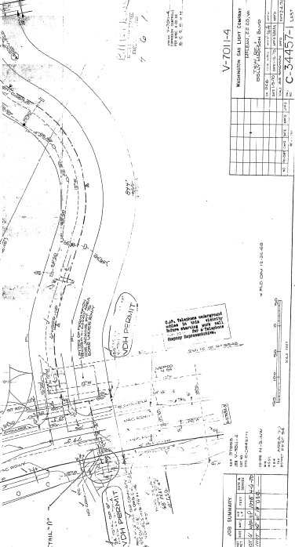
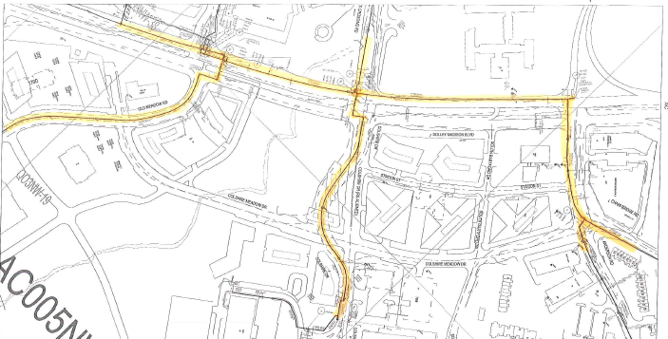
Desktop Research
Used SmallWorld to identify gas lines
Pull As-Builts from Washington Gas Light (WGL) Database

Slide 13
Desktop Research
Used SmallWorld to identify gas lines
Pull As-Builts from Washington Gas Light (WGL) Database

Slide 14
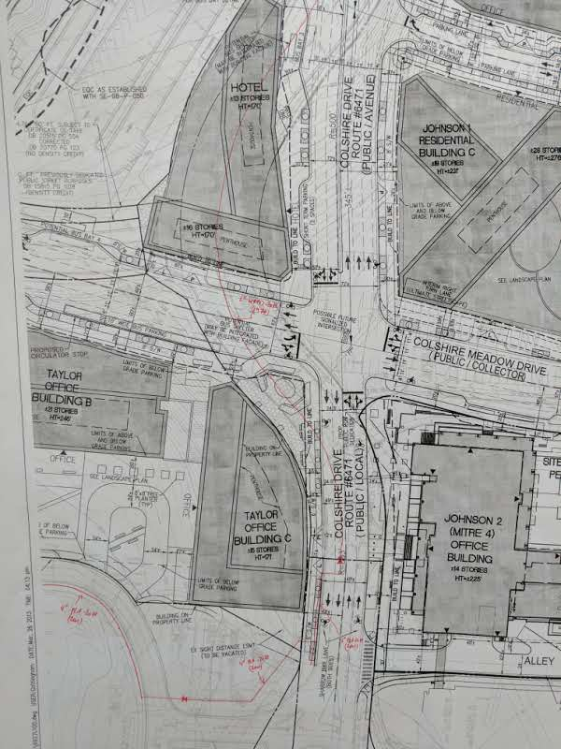
Redlining
Use documents from WGL databases
Trace gas mains with a red pen
Label gas lines by material and year

Slide 15
Redlining
Use documents from WGL databases
Trace gas mains with a red pen
Label gas lines by material and year

Slide 16
Redlining
Use documents from WGL databases
Trace gas mains with a red pen
Label gas lines by material and year

Slide 17
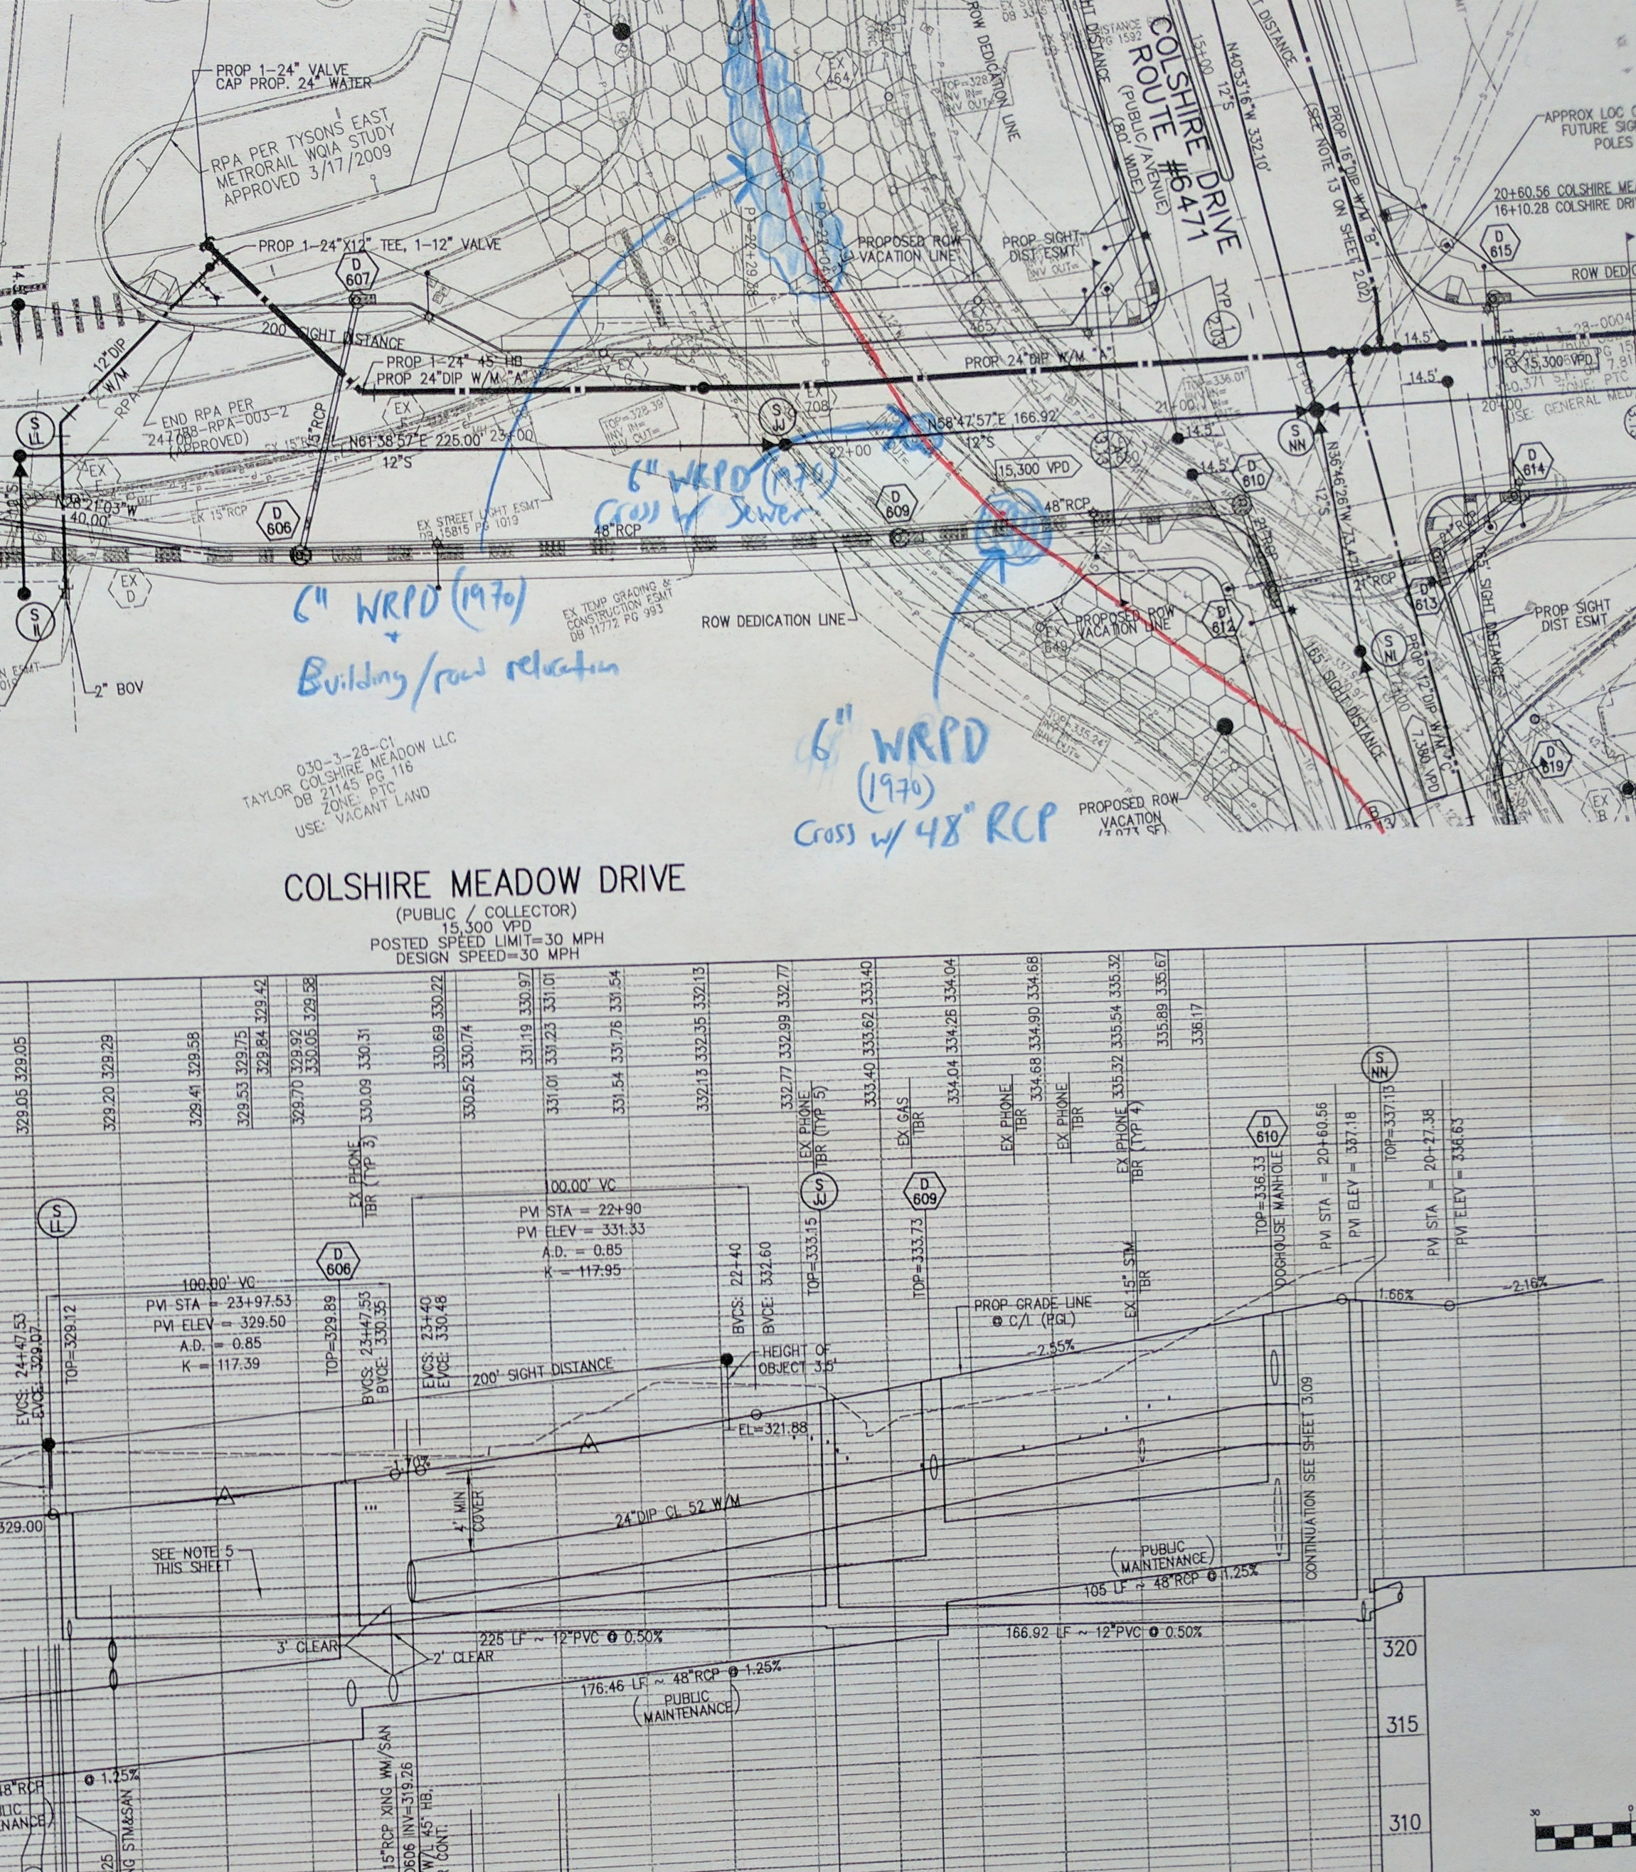
Conflicts
Identify any conflicts with gas mains
RCP, Manholes, Bio retention, Buildings, etc.
Put together a conflict form and letter
Determine what needs to be moved

Slide 18
Conflicts
Identify any conflicts with gas mains
RCP, Manholes, Bio retention, Buildings, etc.
Put together a conflict form and letter
Determine what needs to be moved

Slide 19
Conflicts
Identify any conflicts with gas mains
RCP, Manholes, Bio retention, Buildings, etc.
Put together a conflict form and letter
Determine what needs to be moved

Slide 20
Conflicts
Identify any conflicts with gas mains
RCP, Manholes, Bio retention, Buildings, etc.
Put together a conflict form and letter
Determine what needs to be moved

Slide 21
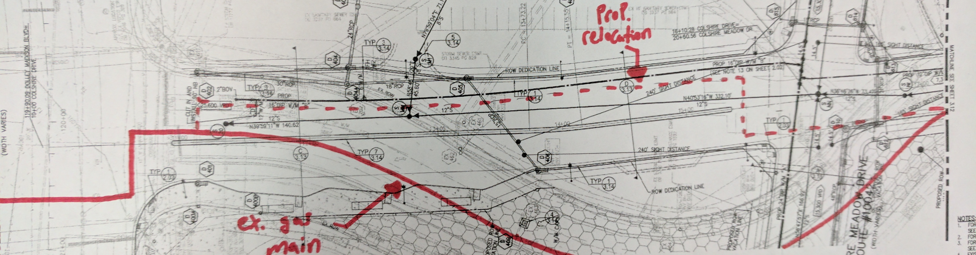
Redesign
Freedom to design path
Consider Roadways & Other Utilities

Slide 22
Redesign
Freedom to design path
Consider Roadways & Other utilities

Slide 23
Lessons Learned

Slide 24
Lessons Learned
Learned an incredible amount about the Natural Gas Industry
Increased my Time Management and Project Management skills
Interfacing with a team and clients to complete a project

Slide 25
Lessons Learned
Learned an incredible amount about the Natural Gas Industry
Increased my Time Management and Project Management skills
Interfacing with a team and clients to complete a project

Slide 26
Lessons Learned
Learned an incredible amount about the Natural Gas Industry
Increased my Time Management and Project Management skills
Interfacing with a team and clients to complete a project

Slide 27
Thank You!

Slide 28
Questions?
EN Engineering, LLC
28100 Torch Parkway, Suite 400
Warrenville, Illinois 60555, USA
T: 630.353.4000 F: 630.353.7777
E: info@enengineering.com
www.enengineering.com

Slide 29
Resources/Links
http://www.flaticon.com/free-icon/engineer_248114#term=construction&page=1&position=13
http://www.flaticon.com/free-icon/screen_124650#term=project&page=1&position=31
http://www.flaticon.com/free-icon/settings_126472#term=gear&page=1&position=1
http://www.flaticon.com/free-icon/gas-pipe_248025#term=pipe&page=1&position=39
http://www.flaticon.com/free-icon/info_149150#term=question&page=1&position=1

